Slide 1
PROJECT TITLE : “PATIENT CASE SIMILARITY”
PIP104 University Project-II
Batch Number:145
Roll Number | Student Name
20211CSE0226 | SHALINI S N
20211CSE0228 | SAI PAVAN C
20211CSE0225 | Y UDAY KUMAR
20211CSE0207 | ANIL KUMAR V H
Under the Supervision of,
Dr. / Mr. Riyazulla Rahman J
Assistant Professor - Senior Scale Presidency School of Information Science.

Slide 2
Introduction
Problem Statement:
In healthcare, identifying similar patient cases helps in diagnosing and planning treatments.
Manual search through patient records is time-consuming and error-prone.
Objective:
Develop a system that efficiently identifies similar patient cases based on symptoms and diseases.
Significance:
Facilitates evidence-based medical decisions.
Saves time for healthcare professionals, improving patient outcomes.

Slide 3
Literature Review
Overview of Related Work:
Previous approaches used text mining techniques to analyze patient symptoms.
Systems leveraging TF-IDF, cosine similarity, and clustering methods showed success in basic case matching.
Web-based applications provided interactive but limited functionality for patient similarity search.
Key Findings:
NLP techniques like TF-IDF are effective for text-based data, especially for handling sparse datasets.
KNN is a simple yet robust algorithm for finding nearest neighbors in high-dimensional spaces.
Identified Gaps:
Limited use of interactive visualizations for similarity representation.
Few systems integrate all components (text similarity, ML models, and user-friendly apps).

Slide 4
Proposed Method
Overview: The proposed system integrates machine learning, text similarity, and web technologies to create a comprehensive platform.
Key Features:
TF-IDF: Converts textual symptom descriptions into numerical vectors for similarity analysis.
KNN Model: Efficiently retrieves the top-3 most similar cases using cosine similarity as the metric.
Flask Web App: Provides an easy-to-use interface for healthcare professionals to input queries and view results.
Visualization: Graphical representation of similar cases for better interpretability.
Innovation:
Combines advanced NLP and ML techniques into a practical, real-world application.
Incorporates graph-based output for enhanced user experience.

Slide 5
Objectives
Primary Objectives:
Create a scalable system to find and retrieve similar patient cases.
Enhance decision-making by providing clear, actionable insights on similar cases.
Secondary Objectives:
Design an intuitive web-based interface accessible to non-technical users.
Support visual exploration of data to simplify understanding.
Ensure compatibility with various datasets to expand usability.
Research Goals:
Validate the system’s accuracy using real-world datasets.
Optimize performance for rapid response time.

Slide 6
Methodology
Data Collection:
Utilize a structured dataset containing diseases, symptoms, and treatments.
Ensure dataset cleaning and preprocessing to remove inconsistencies.
Feature Extraction:
Convert symptoms text into numerical representations using TF-IDF, which captures the importance of terms in the dataset.
Model Development:
Use KNN algorithm with cosine similarity for finding nearest neighbors.
Train the model to retrieve the top-3 similar cases efficiently.
Application Design:
Develop a Flask web app with a simple interface for users to input symptoms or disease names.
Generate dynamic visualizations of results using Matplotlib.
Testing and Validation:
Test the app with various disease queries to ensure reliability and accuracy.
Gather feedback to improve functionality and user experience.

Slide 7
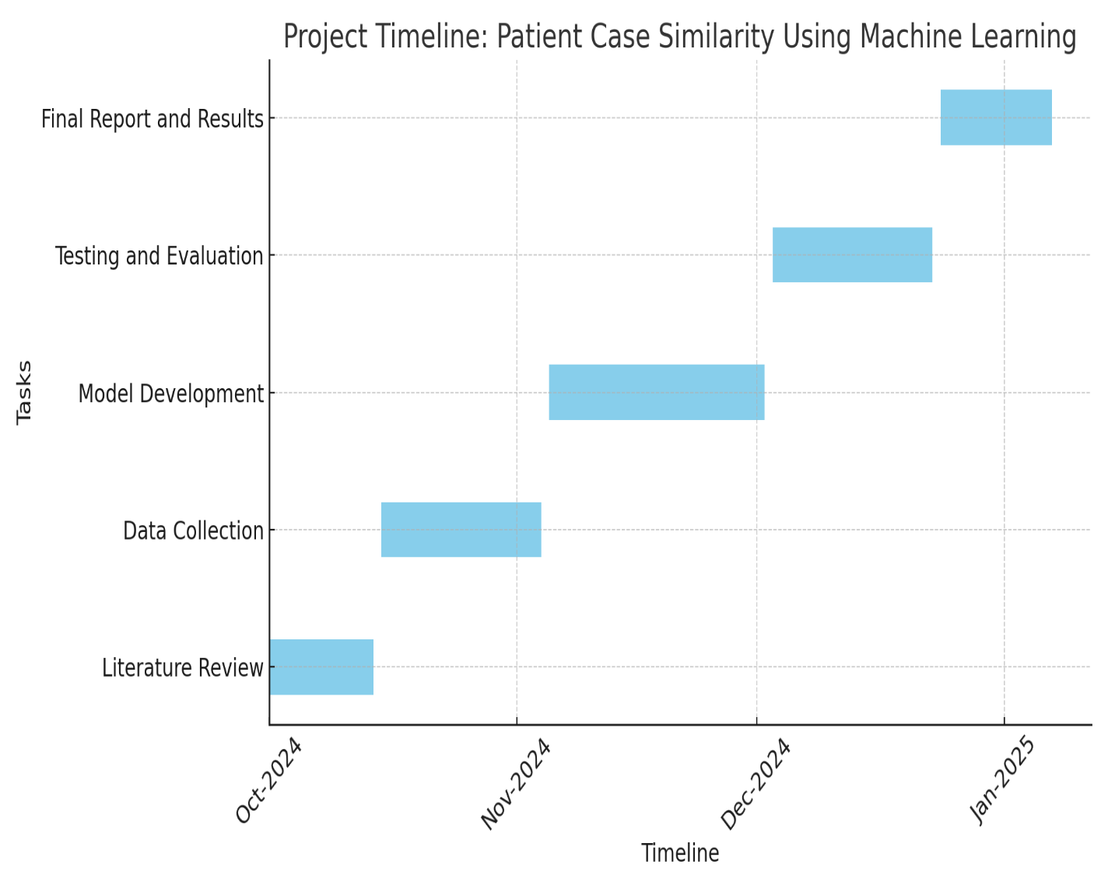
Timeline of Project

Slide 8
Expected Outcomes
Technical Outcomes:
A fully functional system that can retrieve the top-3 similar cases based on symptoms or disease input.
Interactive visual representation of similarity results, aiding understanding and analysis.
Real-time querying with a response time optimized for practical usage.
Practical Outcomes:
Improved accuracy in diagnosing patient conditions.
Faster retrieval of relevant cases, saving critical time for healthcare providers.
Facilitates better treatment planning by analyzing similar historical cases.
Impact:
Bridges the gap between data-driven research and practical healthcare applications.

Slide 9
Conclusion
Summary:
This project addresses the need for efficient retrieval of similar patient cases in healthcare.
The proposed system integrates NLP (TF-IDF), machine learning (KNN), and web technologies (Flask) to create a user-friendly tool.
Visual outputs provide additional clarity, improving decision-making.
Future Work:
Expand the system by integrating larger datasets from diverse medical domains.
Incorporate advanced NLP techniques like BERT or GPT for more nuanced similarity scoring.
Enable multilingual support to cater to diverse populations.
Develop a mobile-friendly version for broader accessibility.

Slide 10
References
[1] Anis Sharafoddini, Joel A. Dubin, and Joon Lee, "Patient Similarity in Prediction Models Based on Health Data" JMIR Medical Informatics, January-March 2017, 5(1): e7 DOI: 10.2196/medinform.5665
[2] Saar, H., & Siedler, D., "A Deep Learning Framework for Predicting Disease Outcomes from Health Data" IEEE Transactions on Neural Networks and Learning Systems, 2021 DOI: 10.1109/TNNLS.2021.3077524
[3] Cheng, Y., Yang, Z., Yang, S., & Sun, J., "Machine Learning for Disease Prediction: A Survey" IEEE Transactions on Biomedical Engineering, 2019 DOI: 10.1109/TBME.2019.2908961
[4] Kim, Y., Kim, S., & Kwon, D., "A Study on the Application of Machine Learning Algorithms for Medical Disease Prediction" IEEE Access, 2020 DOI: 10.1109/ACCESS.2020.2960309

Slide 11
Thank You

